Slide 1
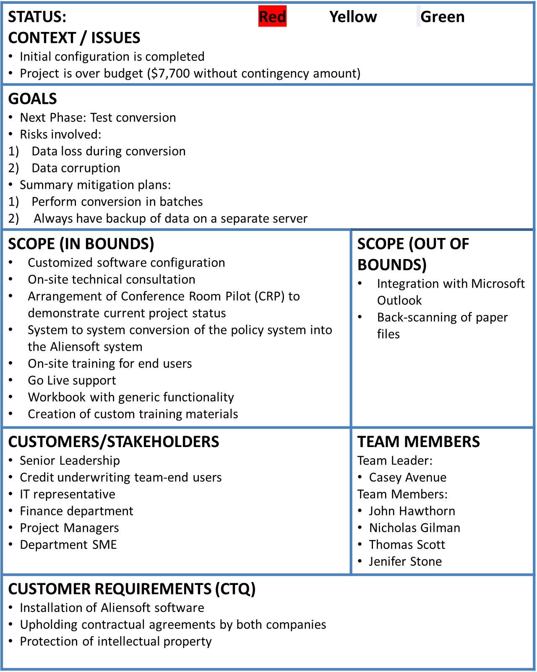
Aliensoft Implementation at AIP
May-01-2017
Tom DiCaprio
VISION OF SUCCESS Improved efficiency of underwriting department Consolidated repository of policy documents
PROJECT SCHEDULE
RESOURCES (other than team members) Time commitment for the project: 11 weeks External Resources: Aliensoft software license, legal paperwork Internal Resources: Office space, Conference rooms Equipment: Computer systems, basic necessary softwares Materials: Printers, VoIP, Stationery
Project Schedule | Owner | Planned Date | Actual Date | % Complete
1. Kickoff Meeting A | Casey Avenue | March 27 | March 27 | 100%
2. Initial Configuration B | Nicholas Gilman | April 3 | April 3 | 100%
3. Initial Configuration C | Nicholas Gilman | April 10 | April 10 | 100%
4. Technical Installs D | John Hawthorn | April 17 | April 17 | 100%
5. Initial Configuration E | Nicholas Gilman | April 24 | April 24 | 100%
6. Test Conversion F | John Hawthorn | May 1 | May 1 | 10%
7. Conference Room Pilot Prep G | John Hawthorn | May 8 |  | 0%
8. Conference Room Pilot Prep (CRP) H | John Hawthorn | May 15 |  | 0%
9. Updated configuration, prep for Training week I | John Hawthorn | May 22 |  | 0%
10. Training Week J | Nicholas Gilman | May 29 |  | 0%
Weekend 10 to 11 Production Conversion K | John Hawthorn | June 3 |  | 0%
11. Go Live week L | Casey Avenue | June 5 |  | 0%
Aliensoft Team
Project Lead
Consultants
Senior Leadership
IT team
Trainer

Slide 2
BUDGET ESTIMATION
Project Stage | Week | Cumulative Budget - No Contingency | Cumulative Budget - With Contingency | Actual Cumulative Expenses | Cost Variance (EV-AC) - No Contingency
Kickoff Meeting | 1 | $ 8,600 | $ 9,708 | $ 14,700 | $ (6,100)
Initial Configuration | 2 | $ 15,400 | $ 17,617 | $ 19,900 | $ (4,500)
Initial Configuration | 3 | $ 22,200 | $ 25,525 | $ 27,900 | $ (5,700)
Technical Installs | 4 | $ 35,700 | $ 40,133 | $ 47,300 | $ (11,600)
Initial Configuration | 5 | $ 42,600 | $ 48,142 | $ 50,300 | $ (7,700)
Test Conversion | 6 | $ 50,100 | $ 56,750 | $ 50,300 | $ (200)
Conference Room Pilot Prep | 7 | $ 56,075 | $ 63,833 | $ 50,300 | $ 5,775
Conference Room Pilot (CRP) | 8 | $ 65,575 | $ 74,442 | $ 50,300 | $ 15,275
Updated configuration, prep for Training week | 9 | $ 71,575 | $ 81,550 | $ 50,300 | $ 21,275
Training Week | 10 | $ 88,025 | $ 99,108 | $ 50,300 | $ 37,725
Production Conversion | weekend | $ 102,025 | $ 114,217 | $ 50,300 | $ 51,725
Go Live week | 11 | $ 113,625 | $ 126,925 | $ 50,300 | $ 63,325

Slide 3
ISSUES ENCOUNTERED DURING THE COMBINED WEEK
Event 2 - IT
  The Aliensoft Technical Consultant (Theo Foster) came onsite to install the software on the workstations and also train our Athens Insurance Partner’s Subject Matter Expert (SME) on the Administration of the system including security and maintenance. Theo noticed that the security setup for the domain controller was inappropriate for the Aliensoft implementation.
  John Hawthorn totally rebuild the security setup for all the programs on all the computer programs. This took John another 20 hours of project time that was not budgeted.
Event 3 – Underwriting
  The Athens Insurance Partners SME needed to comment on the configuration and design of the software so that it would fit our business needs for new insurance policies.
  Nicholas Gilman worked diligently with Alexa on the description of each of the processes in the Athens Insurance Partners environment, and Alexa has enough information to configure the system.
Event 6 – Finance
  Athens Insurance Partners received a letter from Aliensoft announcing that the Professional Services Fees would be increased by 10% as of week #6.
  Tom Scott contacted Aliensoft and was able to convince them that changing a signed contract was not a good idea. Aliensoft agreed and sent another letter that stated that the cost increase was only for future work after finishing up the current project.

Slide 4
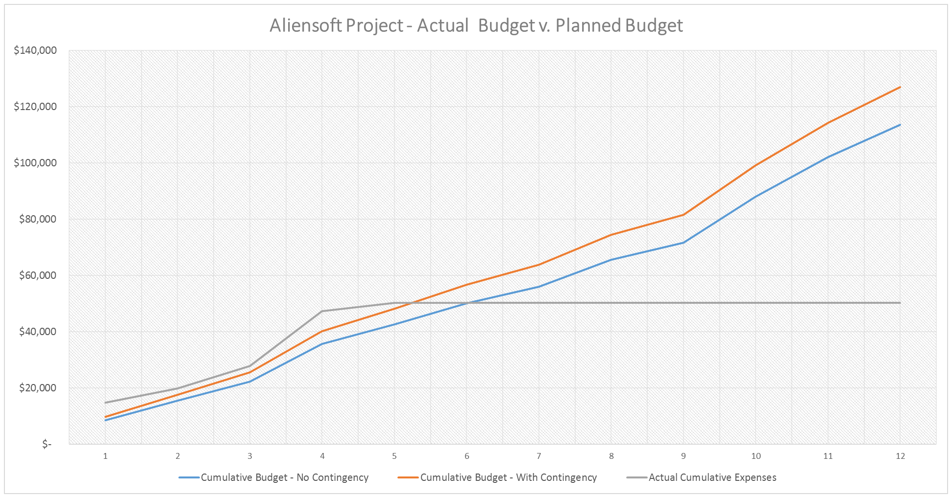
ACTUAL v. PLANNED BUDGET

Slide 5
MITIGATION PLAN
Seek additional funding
  Explain to Tom Dicaprio about the events that led to the project going over-budget and seek additional contingency amount.
Increase offsite consulting by Aliensoft in future
  Persuade Aliensoft consultants to work offsite as much as possible for future weeks.
  This would reduce travel expenses.
Improve co-ordination between Aliensoft and AIP teams
  Motivate teams to maintain high level of communications between them.
  This would reduce any potential surprises(eg. Changes to Professional Services Fees ) in future.
Regular forecasting of resource usage
  Constantly review the number of people currently working on a project and the project's future resource needs on a weekly basis.
Scope management
  Carefully manage scope so that additional work can be captured.
  Seek additional funding to cover the cost of extra work thus maintaining the project under budget.
Maintain functional resources’ work-hour allocation
  Constantly be in touch with departmental managers so that the 3 resources are maintaining their work schedule for this project.

